Slide 1
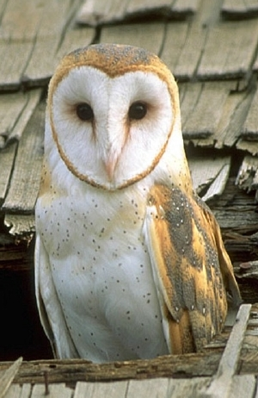
Barn Owl Adaptations

Slide 2
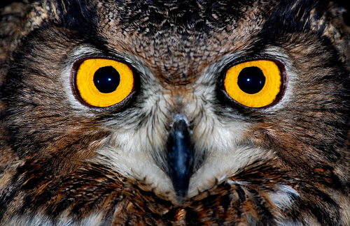
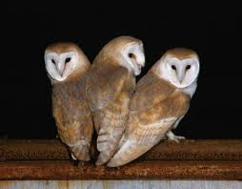
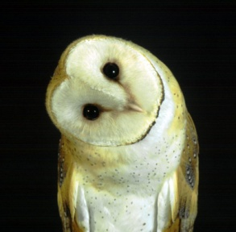
Eyesight
Large Eyes
Eyes do not move so heads must move to see.
Heads can turn 270 degrees
Very little light is needed for an owl to find their prey
Fact – Owls vision is so focused they could read a
Newspaper a mile away by the light of a candle
Fact – Owls must turn their head to see objects up close.

Slide 3
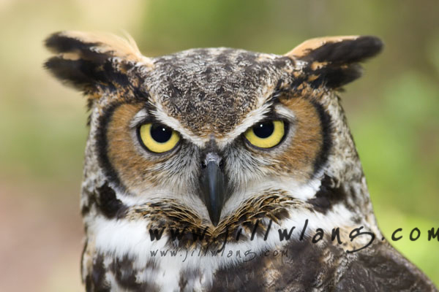
Hearing
Large Oval-shaped ear openings with raised flaps called operculum
Face is shaped like a satellite dish to collect and direct low intensity sounds
Ears are at different heights….if sound reaches top ear first then the sound comes from above
Owl’s sense of hearing is 35 to 100 times more sensitive than a human
An Owl can hear a mouse 60 feet away
An Owl can open and close it’s ears
Facts

Slide 4
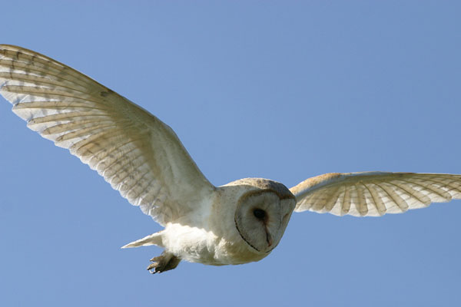
Silent Flight
Owls soft wing feathers allow it to muffle the sound of it flying
Prey cannot hear them coming

Slide 5
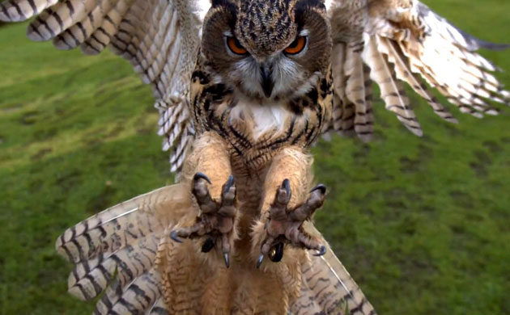
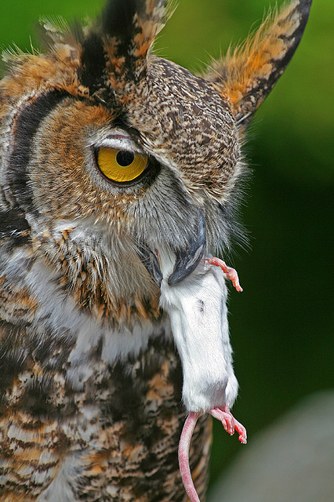
Talons and Beak
Toes of an owl extend to the
sides to prevent small animals
from escaping
Strong, sharp, curved beak allows
owl to tear up prey if too large to
swallow
Usually kill prey by grabbing
with talons and biting its neck

Slide 6
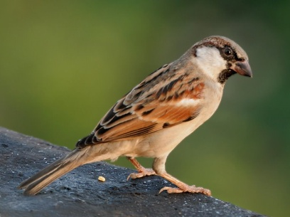
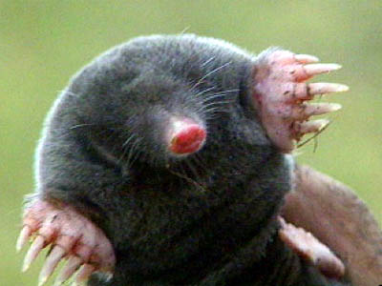
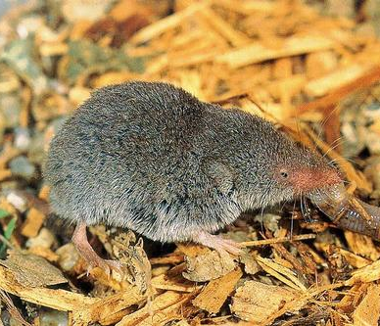
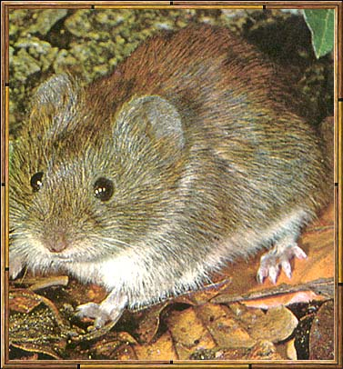
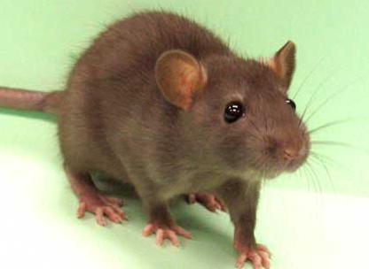
Diet of Barn Owl
House sparrow
mole
Birds
Voles
Shrews
Rats
Moles
Insects
Bats
One year study of a Barn owl revealed the following diet: 1,407 mice, 143 rats, 7 bats, 5 young rabbits, 375 house sparrows, 23 starlings, 54 other birds, 2 lizards, 174 frogs, 25 moths, and 52 crickets
= 2267 creatures eaten in ONE YEAR! (5-6 per night!)
FACT: An owl will expel a pellet 10-18 hours after eating it’s prey. It cannot eat again until it does this
shrew
vole
rat

